Slide 1
Visual Basic for Applications - The Environment
What is an event-driven program?
A user interface?
Notes:
Visual Basic
A program's ability to respond to events forms the basis of event-driven programming.
The program responds to user-initiated events such as keystroke or click. Examples are
Visual Basic and Java.
programming languages offer a Visual Environment for your work.
Visual Basic programs are created in a building block approach.
In Visual Basic programs you create the graphical user interphase and computer human interface.
You define how the screen will look, the user interactions, and the program responses to the user
interactions all in the user interface.
Visual Basic is important to learn for many reasons. The business college want you to learn
flow charts and the kind of thinking that programmers use. Visual Basic is extremely powerful
and is used to create applications for the PC and to jazz up Windows and Browsers. Also
Excel and Access can be modified with Visual Basic.

Slide 2
Computer Programming
Tell the computer exactly what you want it to do and how to do it
A very detailed “business process model”
Flow chart the logic of the business process to be programmed
The computer does what you tell it to do
this is both good and bad

Slide 3
What is VBA?
Common programming component shared among MS Office applications
Also shared with Visual Basic 4.0 and later
Allows creation and manipulation of application objects such as spreadsheets, databases, documents, mail, projects
Facilitates application interoperability

Slide 4
What does VBA allow you to do?
Create applications based on “programmable” products
Manipulate objects in object model of various products
Customize way product appears to others
Leverage capabilities of pre-built objects in various applications
IT ALLOWS YOU TO DO STUFF IN AN AUTOMATED FASHION
Limited only by your imagination

Slide 5
Why Learn to Program in VBA?
Algorithmic thinking important to business analysis
Business solutions often require some programming
Appreciation of programming by managers
Huge productivity gains possible
Ability to “code” is a very valuable skill
It’s fun

Slide 6
What’s needed from you
No prior programming experience required
A logical mindset
Willingness to experiment and learn
Plenty of practice
Perseverance
It will be frustrating, exacting, challenging, and rewarding

Slide 7
VBA=General Programming+Object Manipulation
Excel VBA Applications
General Programming Concepts
Excel Object Model

Slide 8


The Object Model – an analogy
We have object called Car
Each Car is part of the collection Cars
Each Car has properties that describe it such as: make, model, color, price, age, purpose, etc.
Each Car has methods that control it such as: accelerate, stop, turn left, turn right,, etc.

Slide 9
Object Model for Cars
Hierarchical
Collections are plural
Each object has its own specific set of properties and methods
Cars (Car)
Wheels (Wheel)
Horn
Hood
HoodOrnament
Notes:
9
What might be a method for the Horn object? A property?

Slide 10
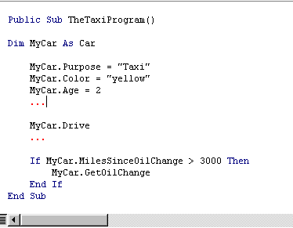
Object Property Values
Car Object is a “template” for creating specific car instances
Each car can have its own set of values for each property
SET property values
Use Drive method
GET a property value and use a method if value meets condition

Slide 11
VBA Object Models
You can view using Office applications as manipulation of various things, or objects
Excel objects: workbooks, sheets, ranges, many more
Word objects: documents, headers and footers, dictionaries, many more
Access objects: forms, reports, macros, queries, many more
Outlook objects: messages, tasks, etc.
Objects of the same type are often grouped into collections
Each Workbook object is part of the Workbooks collection
Objects have attributes that describe them
In VBA, these are called properties, and they take specific values
Example: the Excel Worksheet object has a property called Name that is a text value corresponding to the name on the worksheet tab
You do things with or to an object
In VBA, we use methods to do this
Example: in Excel, we use the Paste method with the Selection object to paste a selection somewhere
Methods may take additional qualifiers to specify how the method is to be performed
Example: the PasteSpecial method needs qualifiers to specify what should be pasted

Slide 12
Objects and Events
Many objects have defined events that get “fired”
When a workbook is opened, its Open event gets fired
Objects can respond to events that get fired
We can tell a workbook to do certain things every time it is opened (e.g. activating a certain worksheet)
We will write event handler code to specify what should happen to various objects when various events get fired

Slide 13
Intro to (MS Excel) Objects
Object – a single unit containing code and data that serve a common purpose
Properties and Methods
Appearance and behavior control
SomeObject.SomeProperty
SomeObject.SomeMethod [method arguments]
Example
Selection.Font.Bold = True
Selection.Font.ColorIndex = 3
Selection.PasteSpecial Paste:=xlPasteFormats

Slide 14
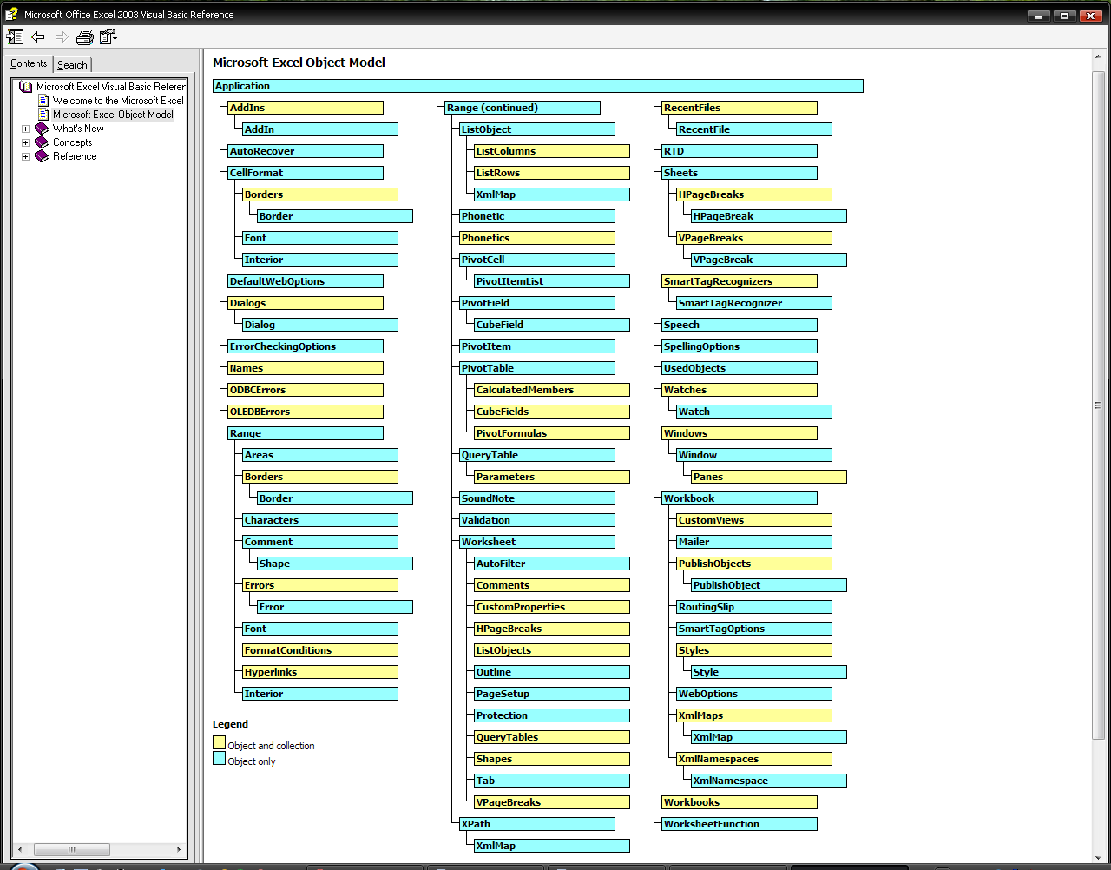

Slide 15
Collections of Objects
Worksheets collection is most common
A collection of Worksheet objects
the Collection itself is an object
collections are usually plural in name
Workbooks, PivotTables, Names, FormatConditions,
We can reference individual objects in a collection by number or name
By index number – Worksheets(1)
By name – Worksheets(“BreakEvenModel”)
Use Count property to see how many items are in a collection
n = Worksheets.Count

Slide 16
Object Models are Hierarchical
Objects are related to other objects in a hierarchical fashion
Higher level objects often consist of many lower level objects
Workbooks made up of multiple worksheets – let’s reference a single sheet in BreakEven.xls
Workbook(“BreakEven.xls”).Worksheets(“BreakEvenModel”)
Dots separate objects in hierarchy
Worksheets(“BreakEvenModel”).Range(“FCost”).Value

Slide 17
Programming with VBA
Figure out what you logically want to accomplish
Pseudo-code and/or Flow chart
Figure out which objects you need to create/modify/access.
Figure out how to use those objects’ properties and methods to do what you want to do.
Hunting through help, common sense, object browser, record a macro
READ and practice from VBA for Modelers

Slide 18
Where does code live in Excel and Access (and Word, etc)?
Code behind forms
Code related to controls on forms
Respond to events (e.g. button click)
Code Modules
General subroutines and functions
Not specific to a form
Visual Basic Editor for both

Slide 19
Visual Basic Editor
Project Explorer
Code Modules
Immediate Window
Object Browser
Locals
Watch
Run, continue, reset
Single step into, over & out
Breaking out
Using Breakpoints
Auto List Members
Auto Quick Info

Slide 20
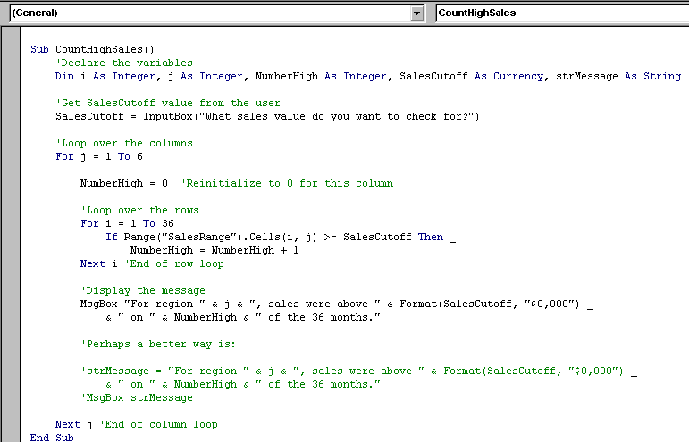
Subroutine declaration
Conditional logic – Check if cell >= SalesCutoff. If so, increment the counter
Inner Loop

Slide 21
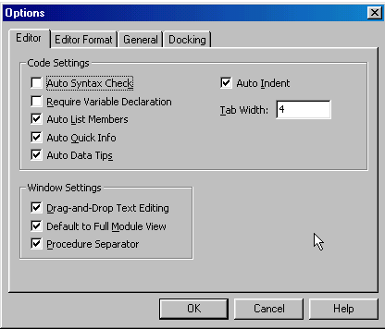
Customizing the VBE
Uncheck to turn off compile error dialogs
Check this to force Option Explicit to be added to your modules which then forces you to Dim all of your variables.

Slide 22
Variables
Temporary storage of values (recall from algebra?)
x=x+1
AvgCost = TotalCost/NumItems
Declare variables with Dim
pick data type for the variable
Reserves memory for the variable
Example: Dim NumItems As Integer
Dim = dimension
Option Explicit
Placed at top of module
forces explicit variable declarations

Slide 23
Some VBA Data Types
Data Type | Descripton
String | for text like “Bob Smith”, literals are enclosed in “”
Integer | Whole numbers in –32768 to 32767
Long | for bigger integers
Boolean | only True (-1) or False (0)
Double | Numbers with decimal parts
Currency | Money (15.4 digits, fixed point)
Date | Dates and times (serial)
Object | All kinds of objects, also have object specific data types
Variant | Catch all type

Slide 24
Structured Programming Concepts
Divide code into independent procedures
Each with its own purpose
Procedures related hierarchically
They “talk” through a list of arguments or parameters
Logic
sequence
selection
iteration

Slide 25
What is an event?
An event is any action to an object that is recognized by an application such as Excel.
Opening or closing an Excel workbook
Clicking on a command button
Changing the data in a cell
An event procedure is code that runs in response to the event.
You decide the events that are significant, then develop the event procedures.

Slide 26
Graphical User Interface
You create the GUI (graphical user interface) / CHI (computer-human interface)
That is: Prompts, questions to the user
Key entry, Mouse Click, Menu Selection, Text or data entry
You decide the program responses to user actions
Including Computations, Change of Interface, etc.
Notes:
user interactions

Slide 27
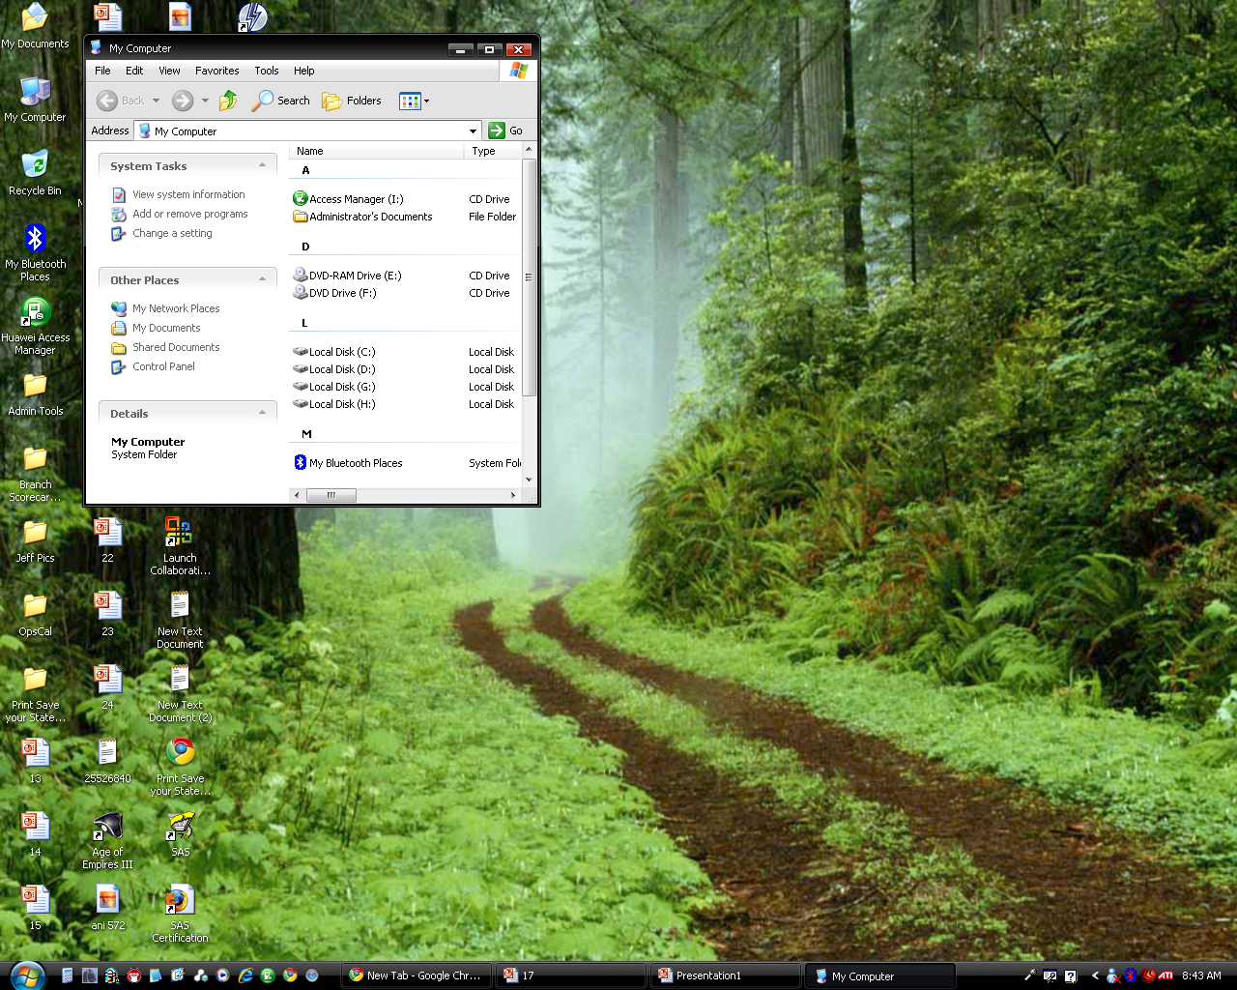
Example GUI

Slide 28
What happens when you use VBA
You create Input Boxes or use controls to gain input from the user.
You insert code behind spreadsheet, in the VISUAL BASIC EDITOR, to process the information.
The basic building block of a VBA program is the procedure.
(subroutine = sub procedure = sub)

Slide 29
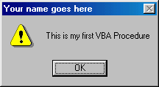
The MsgBox Statement
Displays a message to the user
Three positional arguments
Indicates continuation
MsgBox "This is my first VBA Procedure", _
vbExclamation, "Your name goes here"
MsgBox "Message Caption" , [Button/s,Icon] , ["Caption of the Title Bar"]

Slide 30
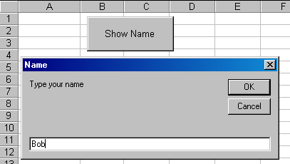
Getting information from the user—Input Box
Range("A1").Value = InputBox("Type your name", "Name")
Input will go to A1

Slide 31
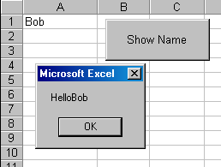
Message Box displays value from Input Box
InputBox obtains data from the user and stores it for later use such as:
MsgBox "Hello" & Range("A1").Value
& Concatenates (joins together) two strings

Slide 32
Calling Event Procedures, Macros
You can run one macro or event procedure from another macro or event procedure.
You "call" it, even if it is stored in another module/worksheet. You call a subprocedure by writing its name:
Sub MySetUP()
Title
Layout
Sheet2.Title
End Sub

Slide 33


Design Mode versus Run Mode
After adding a control, Excel is in "design mode."
Name the control, set its properties now.
To run the control, click on the Design Mode button on the Control Toolbox toolbar—you can toggle in and out of design mode.
Design Mode
Run Mode

Slide 34
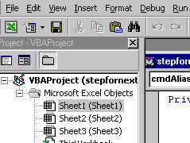

Moving back and forth
To move back and forth between the code and the application, you can double-click on the VBA button to see the code window.
Then, to get back to Excel, click the top left button
or click on the program/VBA icons on the windows bar at the bottom of your screen.
Alt-F11 to toggle

Slide 35
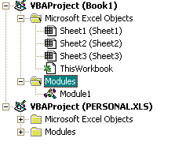
Where is VBA code stored?
By default, macros
just for this workbook
Macros that you use in any of your workbooks

Slide 36
Where is VBA code stored?
By default,
VBA code that
you write for each sheet
or for the whole workbook
By default, macros
just for this workbook
Macros that you use in any of your workbooks

Slide 37
Programs as Recipes
Name of recipe
List of ingredients
bread
peanut butter
jelly
Steps to create the final product
Name of procedure
Declare variables
Dim intCount as Integer
Dim dblCost as Double
Step by step instructions you want the computer to do

Slide 38
Assignment Statement
[Let] Object.property = value
Either of these works:
= value
Let Range("B2").Value = 33
Range("B2").Value = 33
The = sign means "take the value on the right side of the equal sign and assign it to a place in the computer’s memory named on the left side of the = sign."

Slide 39
Let's look at examples of FLAWED assignment statements
33 = Range("B2").Value
InputBox("Hello", "Name") = Range("B2").Value

Slide 40
How the computer reads a line of code
In C language, the ; character tells the computer to stop reading each separate statement
C Language --
Total = subtotal + taxes;
In VBA, the end of the line is considered to be the end of the statement (like a period in English)
Total = subtotal + taxes
In order to force the computer to consider the next line part of the first, we use (space)(underline) as in :

Slide 41
Errors in continuing lines of code
We use an underscore in VBA: __
BAD:
MsgBox "Me Tarzan, you _"
& Range(A1.Value)
MsgBox "Me Tarzan, you"_
& Range(A1.Value)
Don’t put inside the quote
Leave a space!
Notes:
Concatenating Text
Sometimes you want to join two Text items together.
This is the same concatenating that was done in Excel and Access, meaning you use the & sign.
An example of this is VB is: lblMessage.Caption = "Me Tarzan, you " & txtName.Text
Notice the important spaces after you and after the closing quotation.
If you want to put quotes into your concatenation you must use double quotations.
Ex) If you want Me "Tarzan," you "Jane" it would look like this:
"Me ""Tarzan," "You" & """" & txtName.text & """""
When you are continuing long lines in VB you must use the underscore _ to let the computer know
that the line is still continuing.
Ex) lblForiegnFilms.caption=_
"Reading captions is tiring."

Slide 42
VBA Objects, Message Boxes as Functions
What is an object in VBA?
How do you move between design mode and run mode?
How can you make a cell become the active cell?
Notes:
Visual Basic
A program's ability to respond to events forms the basis of event-driven programming.
The program responds to user-initiated events such as keystroke or click. Examples are
Visual Basic and Java.
programming languages offer a Visual Environment for your work.
Visual Basic programs are created in a building block approach.
In Visual Basic programs you create the graphical user interphase and computer human interface.
You define how the screen will look, the user interactions, and the program responses to the user
interactions all in the user interface.
Visual Basic is important to learn for many reasons. The business college want you to learn
flow charts and the kind of thinking that programmers use. Visual Basic is extremely powerful
and is used to create applications for the PC and to jazz up Windows and Browsers. Also
Excel and Access can be modified with Visual Basic.

Slide 43
Objects—in Excel:
Objects represent program entities, or elements that the program manipulates.
e.g. a Worksheet, a Chart
a Command Button, a Range
Objects have _PROPERTIES_ (such as caption, name) and _METHODS_ (such as select, delete, add, clear).
We name objects and refer to them by their name.
Notes:
Properties
methods

Slide 44
Properties
Range("A1").Value = 99
The Value property is what the cell holds, in this case 99
Range("Total").Interior.Color = vbYellow
This changes the color of the cells in “Total” to yellow.
Methods
We can use Range(“A1”).Select
This makes “A1” the active cell

Slide 45
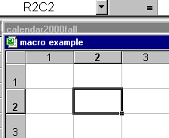
Cells Notation
Remember formula R1C1?
Cells(2,2).Value refers to R2C2 below
Remember, row
first, then column
B3 is the same as
Cells(3,2)

Slide 46
Help on cell notation
One way to identify a cell is through Cells notation:
Range("B1").Value = 8
Range("B2").Value = 8
Can also be written:
Cells(1,2).Value = 8
Cells(2,2).Value = 8

Slide 47
We can use a range NAME to make coding easier
You can work with a range like this:
Range (“A1:C8”) Or, if you name the range, you can call it Range (“PriceList”)
Range(“A1:C8”).Value = 99
Or
Range (“PriceList”).Value = 99
fills every cell in that range with the number 99

Slide 48
Clearing a column
You can clear a column using the ClearContents method:
Private Sub cmdClear_Click()
Range("D:D").ClearContents
End Sub
Note: ClearContents does not clear the formatting, just the numbers or formulas contained within the cells.
What code would you use to clear the contents of a range?

Slide 49

Using the Message Box as a Function
Just as we use the Input Box to get data, we can use the Message Box to gather data from the user

Slide 50
What is the difference?
MsgBox "You are now leaving" , , "Bye"
Cells(1,2) Value = MsgBox(“Quit?”, vbYesNo, “Bye?”)

Slide 51

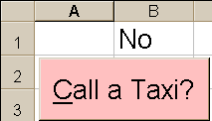
Using the Message Box to Get Data
Private Sub cmdTaxi_Click()
Cells(2,2).Value = MsgBox("Hello", vbYesNo, _
"Do you want a taxi?")
If Cells(2,2).Value = vbYes Then
Range("A1").Value = "Yes"
End If
If Cells(2,2).Value = vbNo Then
Range(“B1").Value = "No"
End If
End Sub

Slide 52

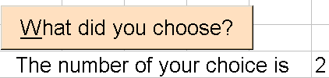
The Message Box Also Returns a Number
Private Sub cmdNumber_Click()
Cells(3,2).Value = __
MsgBox("Make a choice", vbYesNoCancel, "Yes or NO?"
End Sub

Slide 53
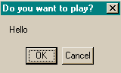
vbOK, vbCancel, etc.
vbOK 1
vbCancel 2
vbAbort 3
vbRetry 4
vbIgnore 5
vbYes 6
vbNo 7
1
2
The MessageBox buttons
return a value that can
be used in programming.

Slide 54
Variables and Constants
What is a variable that you create?
What is a constant that you create?
What is an intrinsic (built-in) constant?
What variables are built in?
What is a data type?
Notes:
Answers to Pre-Lecture Questions
1) An intrinsic constant is built in.
2) A variable changes during the program.
3) A data type is how we store data.

Slide 55
Note—your VBA book may not use our naming conventions!
You need to learn to use our conventions so your code will be easy to read and evaluate.
NOTE: Important material on VBA is at the start of the VBA lecture slide section, so read it before you do your MP!!
And now, onto variables…

Slide 56
Data -- Variables
Variables are memory locations that hold data that can change during the execution of the program.
The properties of an object are all variables that can change.
For example, Enabled = True can be changed to Enabled = False

Slide 57
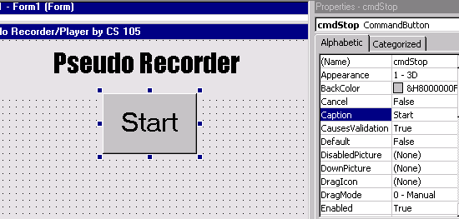
Where are the properties stored in memory?
The computer loads the workbook into memory (RAM), and a place in memory is assigned to each property of each object. What if cmdRun = enabled?
The computer takes the value on the right side of the property box and stores it in the place in the computer’s memory named on the left side property box.
cmdRun

Slide 58

Variables
RAM
Dim intNum as integer
intNum = 99
Range("B1").Value = intNum
intNum
99
99

Slide 59

Why do we use variables?
Say we have a problem: We want to exchange the values in cells A1 and C1. If we do the following, it won’t work:
Range("A1").Value = Range("C1").Value
Range("C1").Value = Range("A1").Value

Slide 60
Why we use variables
We can introduce a user-defined variable called vntTemp and solve the following by
vntTemp = Range("A1").Value
Range("A1").Value = Range("C1").Value
Range("C1").Value = vntTemp

Slide 61
Creating a Variable
You can also name and create your own variables.
Variant means the data can be used as text or as a number. Integer means it is a whole number. We will cover this in more depth later.
Dim vntName as Variant
Dim intNum as Integer

Slide 62
Rules for Forming Names for Constants and Variables
Names MUST
have no spaces or periods
not conflict with reserved words (such as print, name, and value)
Naming conventions
be meaningful
prefix that indicates the type (and other things)
Constants: Please use UPPERCASE in CS105

Slide 63
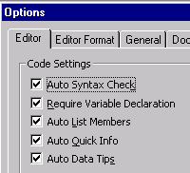
Proper Naming is a MUST
Programmers make mistakes, therefore
we force people to use
Option Explicit
and correct naming
You find this on the
Tools Menu/Options.
With Option Explicit
you must use Dim
and Const

Slide 64
Intrinsic Constants
____________constants are built-in:
vbWhite
vbMagenta
Notes:
Intrinsic

Slide 65
Named Constants
Data items that remain the same are called constants. Constants remain the same until the programmer changes them. The user cannot alter them (you can only change them at one place in the code—this place)
You declare a constant identifier in VBA by giving its name, its data type, and its value.
Examples of acceptable named constants:
Const strCOMPANY As String = "Spyglass"
Const curTAX_RATE As Currency = .08

Slide 66
Constants and Data Types
Const curTAX_RATE As Currency = .08
Prefix of the name curTAX_RATE indicates the type and scope of the constant or variable
Currency is a data type--it limits the size of the number stored to only four decimal places.
If you enter 89.897097 it will store only 89.8971

Slide 67
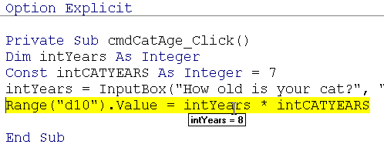
Debugging code
Variables hold values that you can check while the code is stepping through…

Slide 68
Variables and Constants use the same data types – our text book is not consistent in naming them, but you must be
Dim strName as String
Gives size of memory to reserve
States the data type to expect

Slide 69
Data Types
Data Types determine the storage space a program will use to store a constant or a variable.
Some data types are:
Boolean True or False blnAnswer
Currency Large, but only four decimal places (8 bytes) curIncome
Single 7 significant digits (4 bytes)
sngNumber
(what is the largest # it can hold?)
Notes:
Data Types
Data Types determine the storage space a program will use to store a constant or a variable.
The prefix of the name curTAX_RATE indicates the type and scope of the constant or variable.
Currency is a data type and it limits the size of the number stored to only four decimal places.
For example if you enter 89.8989789 it will only be stored as 89.8989
More information on Data Types is on page 87 in the VB book.
There are many different types of data types. Some examples are listed below.
Double means that only 15 significant digits are kept. (dbl)
Integer means that whole numbers are stored up to 32,767. (int)
Long can hold larger whole numbers. ( lng)
String can hold 1 byte per character, letters, digits, and other characters. (str)
Variant holds everything but it takes up a lot of space. ( vnt)
Once the program rounds a number to fit into a particular data type it is gone and the whole
number can not be used later in the program.

Slide 70
Data Types
Double 15 significant digits (8 bytes)
dblMass
Integer Whole numbers only up to 32,767 intIndex
Long Larger whole numbers lngPopulation

Slide 71
More data types
String 1 byte per character, letters, digits, and other characters (569-00-8978)
strName
Variant Holds everything, converts from
one type of data to another, but takes a lot of space vntInput
(for example, user might enter '3' or 'three')

Slide 72
Error!
Programs execute code one line at a time, going from the top to the bottom.
What is wrong with this code:
Option Explicit
Private Sub cmdDisplay_Click()
Dim intNum As Integer
Range ("B1").Value = intNum
intNum = 8754
End Sub

Slide 73
Local Variable
A variable may be used only in a single procedure (local variable). It is
declared in that procedure (a button click, for example)
only available to that procedure
used in that procedure, and then
discarded when that procedure finishes (the next button click creates it anew in a different part of memory).
Private Sub cmdAdd_Click()
Dim intTotal as Integer
intTotal = InputBox("Pick a number")
Range("A2").Value = intTotal
End Sub
Notes:
Scope of Variables and Constants
A variable can be used in a single procedure and would be called a local variable.
The variable would be declared in that procedure and would be used in the procedure
and then discarded when that procedure finishes.
A variable could also be used by many different procedures. This is called a module-level
variable.
This would be declared in the General/Declarations section of the code.
A module level variable has a prefix of "m" in front of it.
Character and Numeric Values
The text box control holds characters that the user types in.
The numbers are stored in two different ways. These are typed characters(strings) or
binary numbers which can be used in calculations.
We have to convert from the character form to the binary form in order to perform a calculation
on it.
The Val function is a Built in function in VB.
THe Val function takes a character string as input (argument) and calculated the binary value of
the input.
Visual Basic has built-in functions just like Excel.
A function performs an action and returns a value.
The expression to operate on, called the argument must be enclosed in parentheses.
Examples of functions that are built in are Val and FormatCurrency.

Slide 74
What could be confusing here?
Private Sub cmdShow_Click()
Dim intTotal as Integer
Range("A2").Value = intTotal
End Sub
Private Sub cmdReveal_Click()
Dim intTotal as Integer
intTotal = InputBox(“Enter a number")
Range("A3").Value = intTotal
End Sub

Slide 75
If, If Else Statements
What does If / Then do?
Is Else necessary?
What is Pseudocode?
Does the computer skip lines of code?

Slide 76
Programming Tools:
Flowchart
Logic diagram to describe each step that the program must perform to arrive at the solution.
A popular logic tool used for showing an algorithm in graphics form.
Pseudocode
A program design technique that uses English words.
Has no formal syntactical rules.

Slide 77
Key parts of a flowchart
A programmer prepares flowchart before coding.
Common flowchart symbols are:
Oval—terminal point, start or end
Diamond—decision symbol

Slide 78
Making Decisions: If Statements
With If statements we will begin to skip or omit lines in the program (!)
If condition is true Then
If test is True execute the statements
(one or more lines)
If test is False, skip all the statements
down to End If
Notes:
We have said that one of the two fundamental things a computer can do is to make two-way decisions, such as whether one value is greater than another, or whether some condition is true or false. Most programs require decisions of these kinds in many places.
In VB, we have a statement, If-Then-End-If which is used to test a condition and to mark which commands are to be executed if the condition is true:
If condition Then
Statements
End If
This means to test whether the condition (a Boolean value) is true or false, and if it is true, to execute the Statements (one or more lines); if the condition is false, all the Statements down to the End If are skipped over and are not executed.

Slide 79
Flowchart of a simple If statement:
If
Condition
True
False
Statements before
the End If
Execute next
statement after End If
in procedure

Slide 80
Simple decision-making statement
Private Sub cmdPasword_Click()
Dim strPassword As String
strPassword = InputBox("Enter Password")
If strPassword = “CS105" Then
MsgBox "Congrats!", vbOKOnly, "Success"
End If
End Sub

Slide 81
Using Else
First, test whether the condition is true or false
If it is true, Then
execute the statements for True case
then skip down to the End If
If it is false,
skip all the statements down to the Else
execute the statements
then go to the line after End If

Slide 82
Two-Way Decisions: If-Else Flowchart
If
Condition
True
False
Statements between
the Else and End If
Statements between
Then and Else
Execute next
statement after End If
in procedure
Notes:
Often when we test whether some condition is true or false, we want our program to fork, taking one path in the true case and a different path in the false case.

Slide 83
Two-way decision-making statement
Private Sub cmdPasword_Click()
Dim strPassword As String
strPassword = InputBox("Enter Password")
If strPassword = “CS105" Then
MsgBox "Congrats!", vbOKOnly, "Success"
Else
MsgBox "Sorry!", vbOKOnly, "Failure"
End If
End Sub

Slide 84
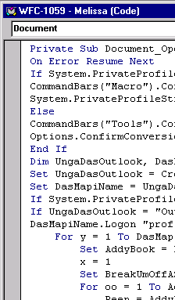
Just to let you know…Computer Viruses
Hackers claim that they
"do it for the challenge."
Hacking is no challenge.
It's easy. You just need minimal
skills and persistence.
The challenge is in stopping hackers and in making systems secure.
Viruses make computer
systems less useful for everyone.
We're lucky more harm
has not been done.

Slide 85
Nested If Statements in VBA
What is a compound condition that we evaluate?
What is a Nested If statement?
How do we use ElseIf?

Slide 86
Compound Conditions -- Review
If intA = 26 intB = 34 intC = 16 Then
intA < intB is True
intB < intC is False
(intA < intB) And (intB < intC) is False
(intA < intB) Or (intB < intC) is True
Not (intB < intC) is True
Notes:
Compound Conditions
Example) Suppose that intA=26 adn intB=34 and intC=16. Then one can use the following
compound conditions.
intA
(intA
(intA
Not (intB
Nested If Statements
The statements in the true clause can be anything, including another If Statement. Likewise,
the statements in the false clause. These are called nested If Statements. Use nested If's
when you have multiple decisions as in a decision tree. Example of a nested If.
IF optBlue.Value=False Then
IF optRed.Value=True Then
lblOne.Backcolor=vbRed
Else
lblOne.Backcolor=vbGreen
End IF
Else
lblOne.Backcolor=vbBlue
End IF
End If
***Notice that you have to end each If/Else with an End IF.
**ElseIf is another way to write code which is easier to read and less clunky. You do not
have to use 2 End If's. Example
If optBlue.Value= True Then
lblOne.Backcolor=vbBlue
ElseIf optRed.Value=True Then
lblOne.Backcolor=vbRed
Else
lblOne.Backcolor=vbGreen
End IF
Calling Event Procedures
See pages 143-145 in VB book for more info. It is useful to use this when you want to clear all
boxes with one button but need to use the code under another to clear all of them. Example
Private Sub cmdNextPatron_Click()
'clear current service
cmdClear_Click
lblTotal.Caption=""
***Read pages 152-161 in order to learn about debugging a program. Pay special attention to
breakpoint, Step into, Step Over, and Run-Time error.

Slide 87
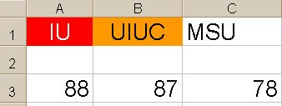
Example of NOT – Track Meet Scores
Private Sub cmdNotExample_Click()
Dim intIU As Integer
Dim intUIUC As Integer
Dim intMSU As Integer
intIU = Range(“A3").Value
intUIUC = Range(“B3").Value
intMSU = Range(“C3").Value
If Not (intUIUC < intMSU) And Not (intUIUC < IU) Then
Range(“C5").Value = "We won, We won!"
End If
End Sub

Slide 88
Nested If Statements
Use Nested If when you have multiple decisions, as in a decision tree.
You use Case Statements when a variable has multiple values
(we will cover Case Statements next)

Slide 89
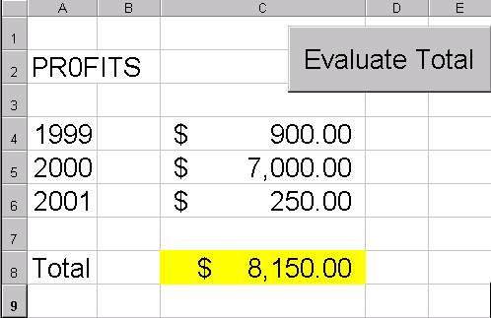
Putting it all together with Excel
We named this cell “Total”

Slide 90
What does this code do?
Private Sub cmdEvaluate_Click()
If Range("Total").Value > 5000 Then
Range("Total").Interior.ColorIndex = 6
Else
If Range("Total").Value > 3000 Then
Range("Total").Interior.ColorIndex = 8
Else
Range("Total").Interior.ColorIndex = 4
End If
End If
End Sub

Slide 91
What does this code do?
Private Sub cmdEvaluate_Click()
If Range("Total").Value > 5000 Then
Range("Total").Interior.ColorIndex = 6
ElseIf Range("Total").Value > 3000 Then
Range("Total").Interior.ColorIndex = 8
Else
Range("Total").Interior.ColorIndex = 4
End If
End Sub

Slide 92
Putting it all together with Excel, Else/If
Private Sub cmdEvaluate_Click()
If Range("Total").Value > 5000 Then
'Yellow should show the profit!
Range("Total").Interior.ColorIndex = 6
ElseIf Range("Total").Value > 3000 Then
' light blue gives us a warning
Range("Total").Interior.ColorIndex = 8
Else
'We feel sick...green
Range("Total").Interior.ColorIndex = 4
End If
End Sub

Slide 93
Nested If Flowchart
If
Test Condition
False
True
ElseIf
Statements below the If, stop at ElseIF
Test Condition
True
False
Statements below
Else
Statements below
ElseIf
Execute next
statement after End If
in procedure
Notes:
Often when we test whether some condition is true or false, we want our program to fork, taking one path in the true case and a different path in the false case.

Slide 94
Case Statements
When do we use a Case Statement?
What does Case Else mean?
What is Case Is?

Slide 95
Setting up the Case Statement
First, you need to tell VBA which variable or expression that you are checking
Select Case vntTest
---Or---
Select Case vntTest + 1
Three types:
Case 2, 6, 8
Case 2 To 8
Case Is <= 8

Slide 96
The Case Statement
Preferable to the IF statement for a multi-branch situation
Select Case vntTemp
Case 90
Range(“A2”).Interior.Color = vbYellow
Case 80
Range(“A2”).Interior.Color = vbGreen
Case 70
Range(“A2”).Interior.Color = vbRed
Case Else
Range(“A2”).Interior.Color = vbBlue
End Select

Slide 97
Select Case – Example –We can use this later in loops!
Select Case vntPercentage
Case Is > = 0.90
strGrade = "A"
Case Is >= 0.80
strGrade = "B"
Case Is > = 0.70
strGrade = "C"
Case Is > = 0.60
strGrade = "D"
Case Else
strGrade = "Less than D"
End Select

Slide 98
Checking a variable, showing a picture
(hide all the pictures each time you click on the button)
intMonth = InputBox ("Type the number of the month", _ "Month", 12)
Select Case intMonth
Case 12, 1, 2, 3
imgCold.Visible = True
Case 4 To 6
imgSpring.Visible = True
Case 7 To 8
imgSun.Visible = True
Case 9 To 11
imgFall.Visible = True
Case Else
(show a message box)
End Select

Slide 99
Displaying the month…
intMonth = InputBox("Enter the number of a month", _
"Entry must be between 1 and 12")
Select Case intMonth
Case 1
strMonth = "January"
Case 2
strMonth = "February"
Case 3
strMonth = "March “
(and so on…)

Slide 100
End of Part 1

